Slide 1
Fuzzy logic for mobile robot navigation
Ben Church

Slide 2
Content
Mobile robot navigation overview
Nature of environment
Navigation as behavior
Crisp navigation
Environment and behavior analysis
Implementation
Fuzzy navigation
Motivation
Approaches

Slide 3
Mobile robot navigation overview

Slide 4
Navigation analysis
Navigation is iterative, closed-loop
Perception
Modelling
Behavior
Environment

Slide 5
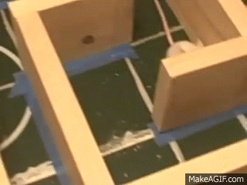
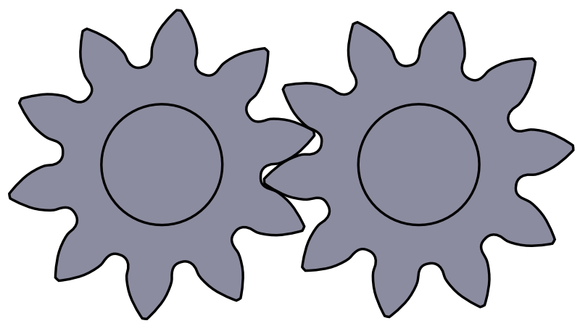
Navigation analysis
Environment determines behavior
Environment
Behavior
https://i.makeagif.com/media/1-22-2016/RbtuUx.gif
https://upload.wikimedia.org/wikipedia/commons/2/22/Spur_gears_animation.gif

Slide 6
Environment
Navigation involves variably general environments
Unknown, dynamic
Unknown, static
Known

Slide 7
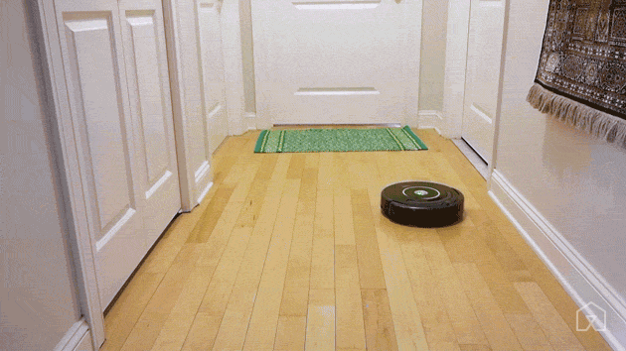
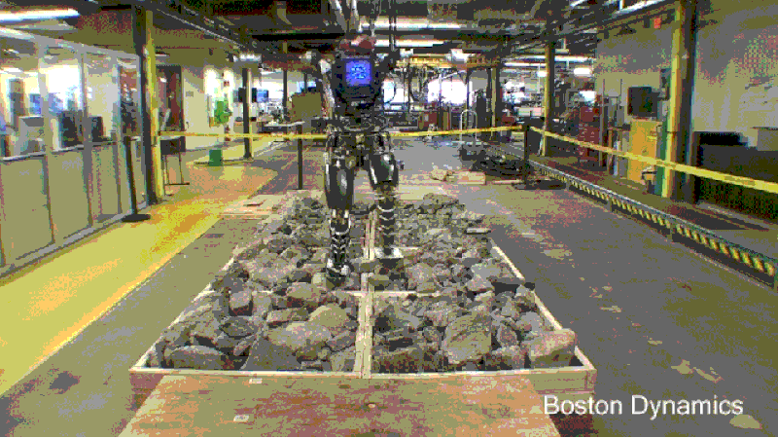
Behavior objective
Continuous operation
Start to end navigation
http://thesweethome5.wpengine.netdna-cdn.com/wp-content/uploads/sites/3/2016/02/03-robot-vacuum-roomba-path-630.gif
https://i.kinja-img.com/gawker-media/image/upload/s--ttt8ckgm--/c_scale,f_auto,fl_progressive,q_80,w_800/1925wnay9ee3ugif.gif

Slide 8
Environment & Behavior
Behavior model dictated by environment
Reactive
Mechanistic
Unknown, dynamic
Unknown, static
Known

Slide 9
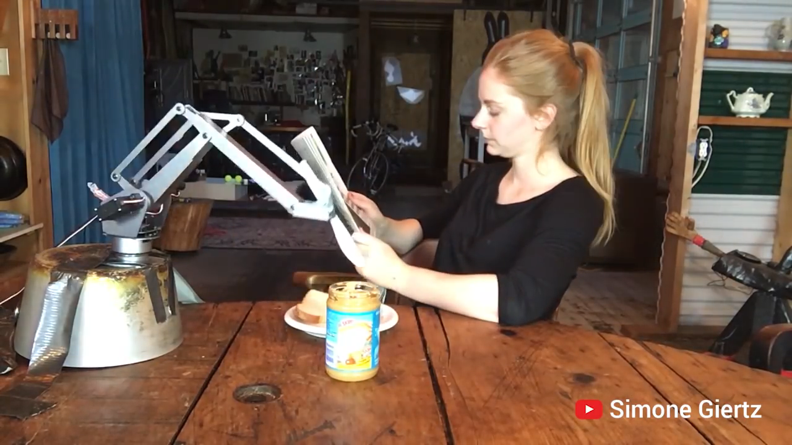
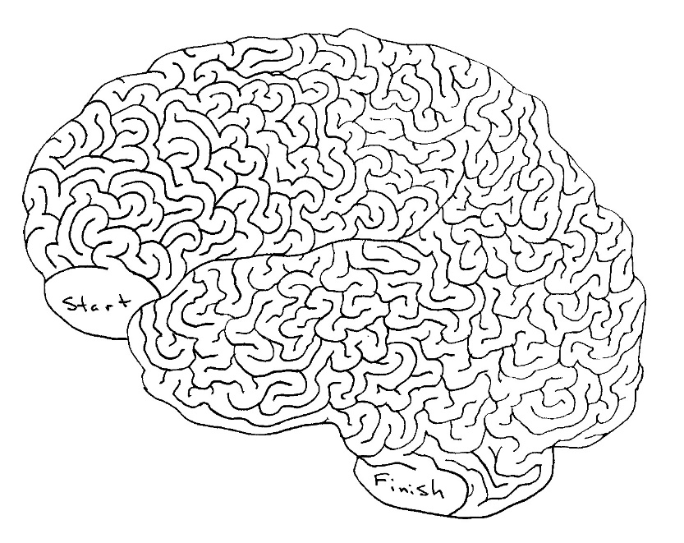
Known - Mechanistic
Model
Behavior
Robot contains environment representation
Open-loop
Unusable in practice
Perception
Modelling
Behavior
Environment
http://braininjurysociety.com/wp-content/uploads/maze.jpg
https://www.youtube.com/watch?v=9CDbl1Y-JOY

Slide 10
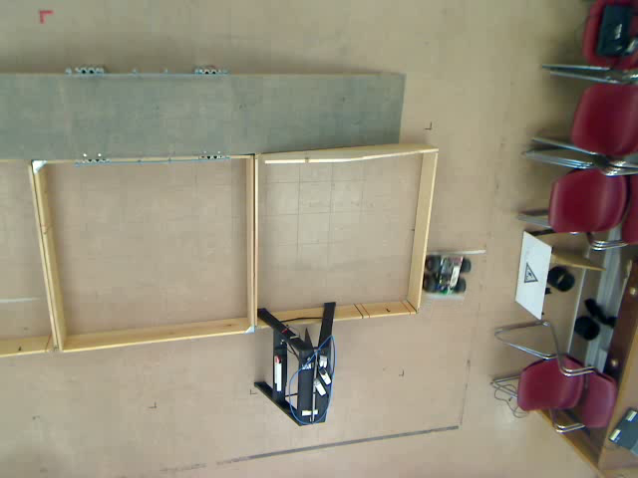
Known - Reactivity
Robot reacts to environmental uncertainty
Used for wall following behavior

Slide 11
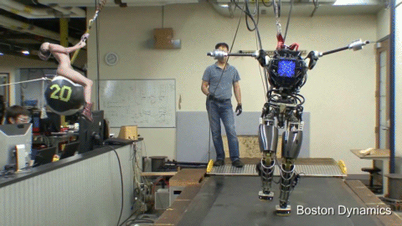
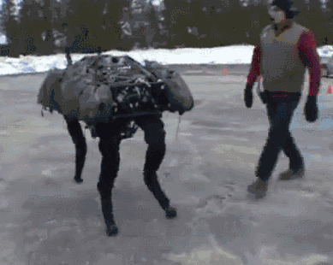
Unknown - Reactive
Robots respond to changing environments or disturbances
http://i.imgur.com/ady1DyR.gif
http://i.imgur.com/ZiFuqF9.gif

Slide 12
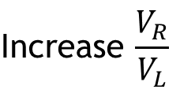
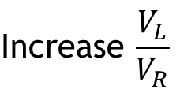
Navigation as wall-following
Robot is engaged with environment
Environmental measurements guide navigation
Wall too far
Wall too near
Measure distance to wall
$$\text{Increase} \frac{V_{R}}{V_{L}}$$
$$\text{Increase} \frac{V_{L}}{V_{R}}$$

Slide 13
General navigation
Closed-loop control
Environment
Behavior
Function of environment
Continuous or start-end
One example: wall-following

Slide 14
Crisp navigation

Slide 15
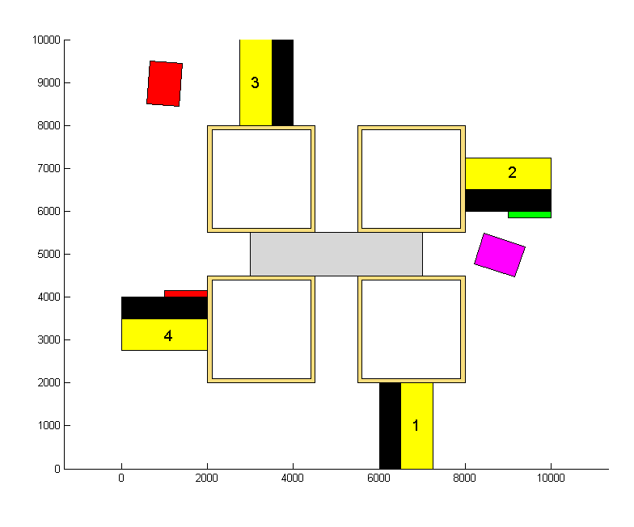
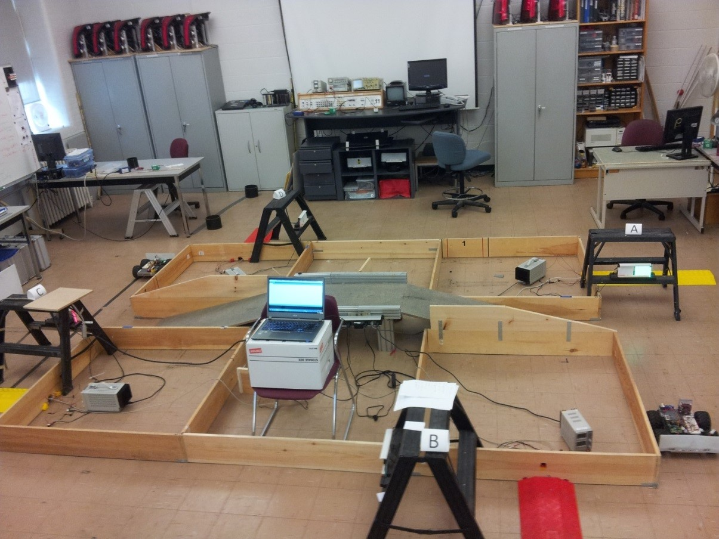
Multiple behaviors
Complex environments require behavior cases
Wall following, gap passing, turning

Slide 16
Multiple behaviors
One behavior at a time
Logical case activation condition

Slide 17
Binary behavior
Such an on-off approach to navigation suitable for known environments
Cannot count through unknown environment

Slide 18
Start-to-end navigation
Unknown environment
Behavior selection no longer a trivial problem

Slide 19
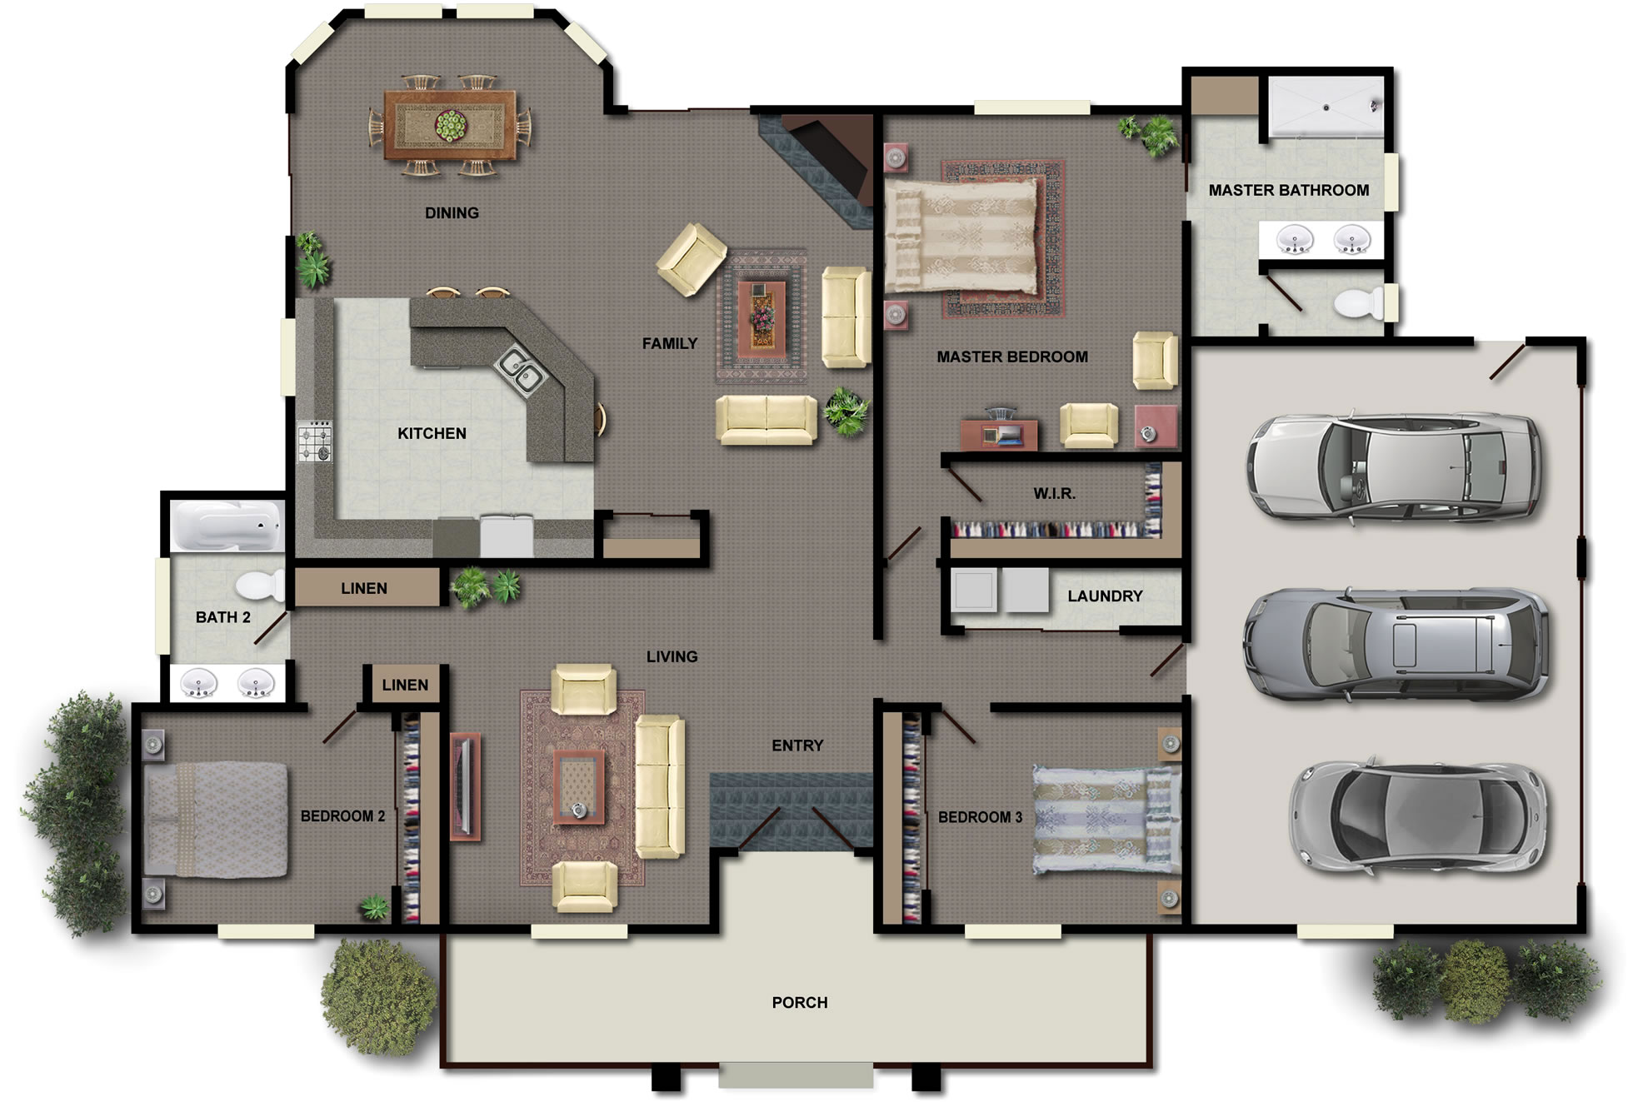
Start-to-end navigation
X
End-goal navigation
Obstacle avoidance
http://houseplans.co.nz/images/house-plans.jpg

Slide 20
Brooks’ subsumption
Brooks [1] selects single most important behavior
High-priority behaviors “subsumpt” others
Explore
Wander
Avoid obstacles

Slide 21
Brooks’ subsumption
Can cause sub-optimal or counter-productive path choice

Slide 22
Rosenblatt and Payton’s voting
Rosenblatt and Payton [2] allow behavior voting
Single best command action chosen
Behavior 1
B₁ × W₁
B₂ × W₂
Vote_{j}
Command_{j}
B₃ × W₃
Behavior 2

Slide 23
Rosenblatt and Payton’s voting
Behaviors were radially arranged headings
Commands corresponding to headings took votes from multiple headings
L
F
F
R
L
R

Slide 24
Arkin’s adding
Arkin [3]* adds each behavior’s direction vectorially
Resorts to Brooks’ subsumption
X
* “Motor Schema Based Navigation for a Mobile Robot: An Approach to Programming by Behavior”

Slide 25
Other approaches
Khatib [4] used potential fields
Althaus and Christensen [5] used nonlinear dynamics

Slide 26
Fuzzy navigation

Slide 27
Combing behaviors
Fuzzy logic can combine behaviors into meaningful action

Slide 28
Target-obstacle fusion
Leyden et al. [7] extend Rosenblatt and Payton’s subsumption [2]
Fuses obstacle avoidance with end-goal direction
F
R
L

Slide 29
Target-obstacle fusion
IF Target Angle is Around 0° THEN Desired Direction is Forward
IF Target Angle is Around 45° THEN Desired Direction is Right Forward
IF Target Angle is Around 90° THEN Desired Direction is Right
IF Forward Sensor is Near THEN Disallowed Direction is Forward
IF Right Forward Sensor is Near THEN Disallowed Direction is Right Forward
IF Right Sensor is Near THEN Disallowed Direction is Right
μ_{Turning Direction} = μ_{Desired AND NOT Disallowed}
= min(μ_{Desired}, μ_{NOT Disallowed})
= min(μ_{Desired}, 1 – (μ_{Disallowed}))

Slide 30
Target-obstacle fusion
Right Forward
Right Forward
Direction membership
Disallowed membership
0°
45°
90°
Near
Mid
Far
Target angle (°)
Sensor reading

Slide 31
Target-obstacle fusion
Each direction membership computed
Multiple peaks can cause collisions
Separate into subsets and choose largest
Right Forward
Forward
Right
0°

Slide 32
Layered waypoint navigation
Yang et al. [8] treat navigation as waypoint selection and steering
(x_{w}, y_{w}, γ)
γ

Slide 33
Layered waypoint navigation
Navigation layer informs steering layer
From first layer
Range sensors
γ
Range sensors
Target heading
Fuzzy logic
Safe direction and speed
Desired direction and speed
Fuzzy logic
Traversable area
Desired area
Command fusion
Command fusion
Way point (x_{w}, y_{w}, γ)
Defuzzification
Steering action
To second layer

Slide 34
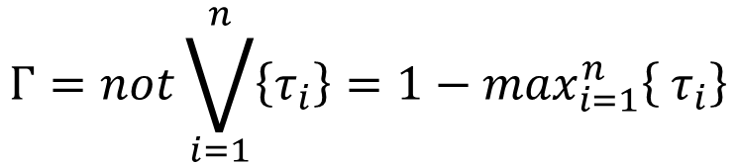
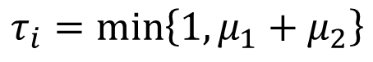
Layered waypoint navigation
τ
μ₁
μ₂
Γ
τ
μ₁
μ₂
0°
45°
90°
135°
180°
-180°
-135°
-90°
-45°
Γ
$$Γ=not\bigvee_{i=1}^{n}{\left\{τ_{i}\right\}=1−\max_{i=1}^{n}\left\{ τ_{i}\right\}}$$
$$τ_{i}=\min\left\{1,μ_{1}+μ_{2}\right\}$$

Slide 35
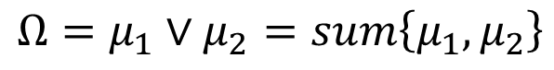
Layered waypoint navigation
φ
Ω
μ₁
μ₂
φ
-180°
-90°
0°
90°
180°
$$Ω=μ_{1}∨μ_{2}=sum\left\{μ_{1},μ_{2}\right\}$$

Slide 36
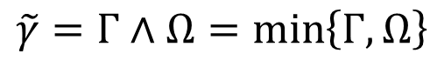
Layered waypoint navigation
(x_{w}, y_{w}, γ)
Γ
γ
Ω
𝛾 ̃
-180°
-90°
0°
𝛾
90°
180°
$$\tilde{γ}=Γ∧Ω=\min\left\{Γ,Ω\right\}$$

Slide 37
Layered waypoint navigation
(x_{w}, y_{w}, γ)
-180°
-135°
-90°
-45°
0°
45°
90°
135°
180°

Slide 38
Layered supervision
Al Yahmedi and Fatmi [9] fuzzified environment model
Fuzzy rule system arbitrates behavior outcome

Slide 39
Layered supervision
S₁
Emergency situation
V₁
RD
…
Obstacle avoidance
LD
Wall following
D_{rg}
Goal reaching
θ_{error}
Behavior activation
S_{b}
Supervisor
V_{b}

Slide 40
Layered supervision
Behaviors:
Goal reaching
Wall following
Obstacle avoidance
Emergency situation

Slide 41
Layered supervision
N
SN
Z
SP
P
Membership
N
S
B
D_{rg}
θ_{error}
-100
-50
0
50
100
0
50
100
θ_{error} (deg)
D_{rg} (mm)

Slide 42
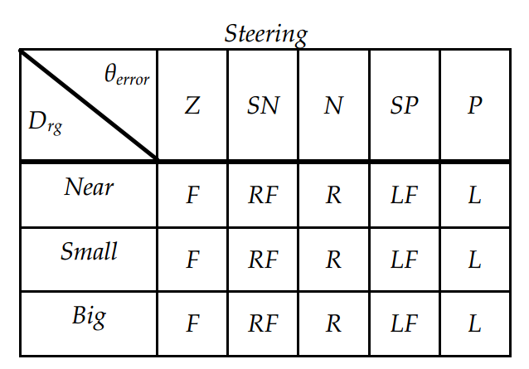
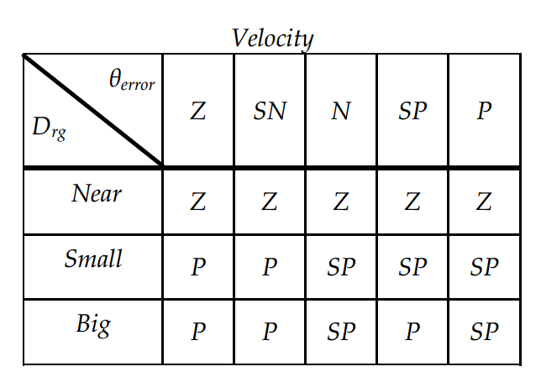
Layered supervision
D_{rg}
θ_{error}
Table 1. Fuzzy table rules for goal reaching behavior.

Slide 43
Layered supervision
14 radial sensors combined into 6 rules
LD = min(⋮,⋮)
FR = min(⋮,⋮,⋮)
FL
FR
LU
RU
LD
RD

Slide 44
Layered supervision
FL
FR
Membership
N
M
F
1
LU
RU
0
0
20
40
60
80
100
LD
RD
Distance (mm)

Slide 45
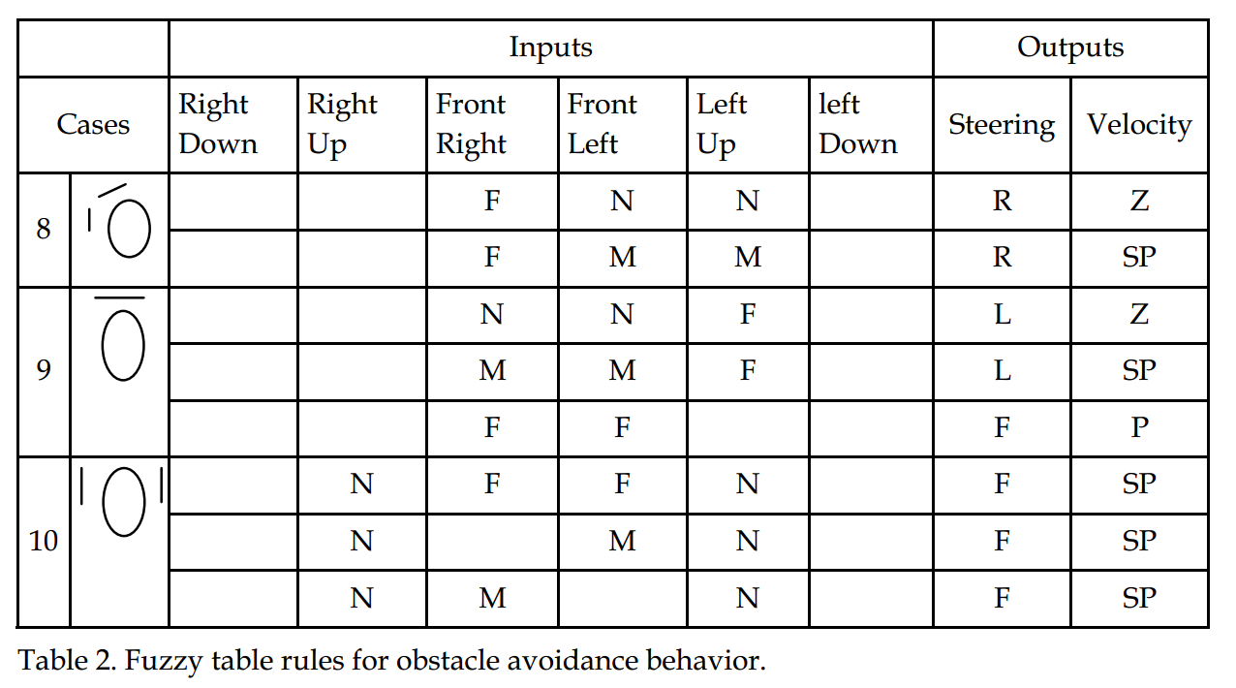
Layered supervision

Slide 46
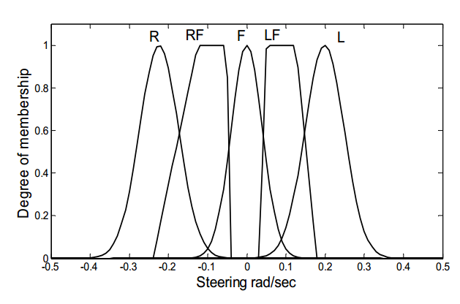
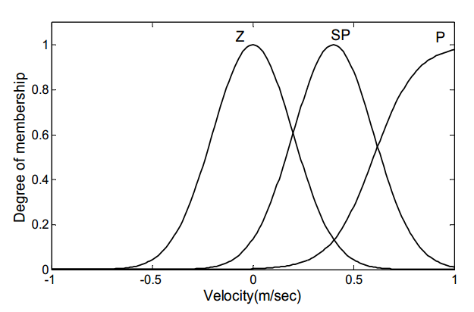
Layered supervision

Slide 47
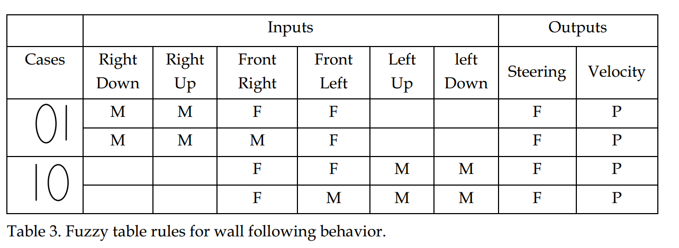
Layered supervision

Slide 48
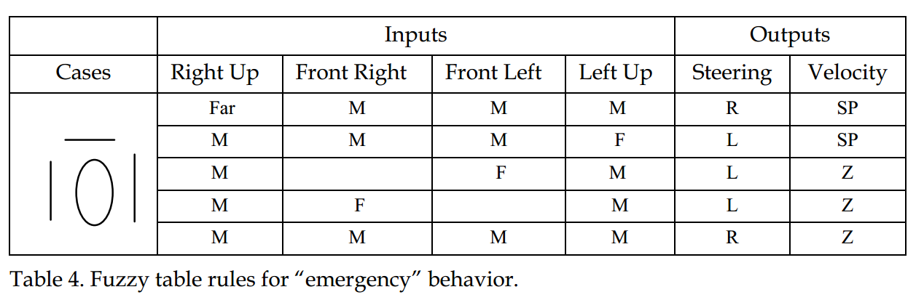
Layered supervision

Slide 49
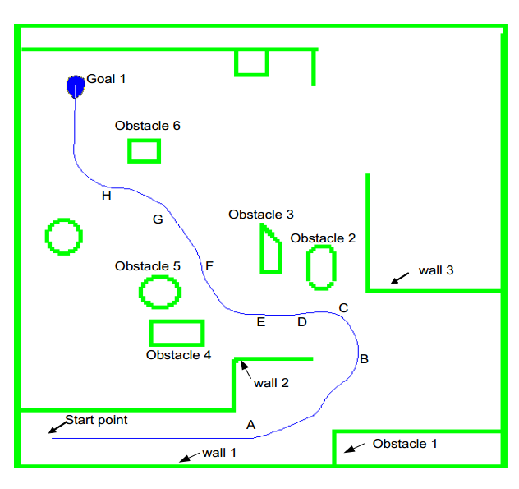
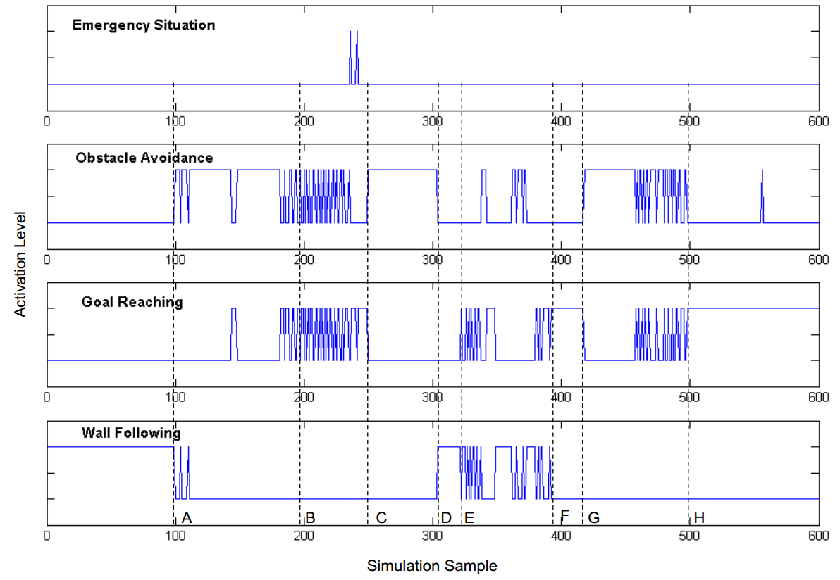
Layered supervision

Slide 50
Recap
Crisp navigation:
Case subsumtion
Voting subsumption
Behavior adding
Fuzzy navigation:
Target-obstacle fusion
Layered waypoint navigation
Layered supervision

Slide 51
Thank you! Questions?

Slide 52
References
Brooks RA, “A Robust Layered Control System For A Mobile Robot”. IEEE Journal of Robotics and Automation, 1986; RA-2(1):14-23.
Rosenblatt JK and Payton DW, “A Fine-Grained Alternative to the Subsumption Architecture for Mobile Robot Control”. IEEE International Joint Conference on Neural Networks, 1989.
Arkin RC, “Motor Schema Based Navigation for a Mobile Robot: An Approach to Programming by Behavior”. IEEE International Conference on Robotics and Automation, 1987.
Khatib O, “Real-Time Obstacle Avoidance for Manipulators and Mobile Robots”. The International Journal of Robotics Research, 1986; 5(1):90-98.
Althaus P and Christensen HI, “Behavior Coordination for Navigation in Office Environments”. IEEE/RSJ International Conference on Intelligent Robots and Systems, 2002.
Leyden M, Toal D, and Flanagan C, “A Fuzzy Logic Based Navigation System for a Mobile Robot”. Proceedings of Automation Symposium, 1999.
Yang X, Moallem M, and Patel RV, “A Layered Goal-Oriented Fuzzy Motion Planning Strategy for Mobile Robot Navigation”. IEEE Transactions on Systems, Man, and Cybernetics, 2005; 35(6):1214-1224.
Al Yahmedi AS and Fatmi MA, “Fuzzy Logic Based Navigation of Mobile Robots”. Recent Advances in Mobile Robotics, InTech, 2011; 287-310.

